Slide 1
WELCOME

Slide 2

Department of Computer Science & Engineering Artificial Intelligence & Machine Learning A.P. Shah Institute of Technology, G.B.Road, Kasarvadavli, Thane(W), Mumbai-400615, UNIVERSITY OF MUMBAI, Academic Year 2023-2024

Slide 3
AI-Powered Career Catalyst
Vaibhav Bura (22106067)
Vivek Dalvi (22106108)
Yash Desai (22106005)
Pratik Dhas (22106063)
Under the Guidance of
Prof. Vijesh Nair

Slide 4
Outline
Introduction
Literature Survey of the existing systems
Limitations of the existing systems
Problem statement
System Design
Technologies and methodologies
Implementation
Conclusion
References

Slide 5
Introduction
Traditional resume creation is time-consuming and may not meet evolving industry demands.
AI-powered career catalysts offer transformative innovation for crafting resumes.
They leverage AI to create intelligent, adaptive solutions for optimizing resumes.
AI-powered resume generators use advanced NLP and machine learning to tailor resumes to specific job requirements.
In the era of information abundance, these tools help job seekers stand out in competitive landscapes.
They enhance efficiency, effectiveness, and personalization of the job application process.
The fusion of AI and resume creation is poised to redefine professional identity showcasing for career opportunities.

Slide 6
Motivation
Industry Demand: Observing the rapid changes in the job market and the increasing reliance on technology for hiring processes likely motivated individuals or organizations to address the need for more efficient and effective resume creation tools.
Challenges of Traditional Methods: Recognizing the limitations and inefficiencies of traditional resume creation methods, such as time-consuming processes and lack of personalization, may have sparked the motivation to innovate in this area.
Advancements in AI Technology: With the advancements in AI technology, particularly in natural language processing and machine learning, there's a growing recognition of the potential to leverage these capabilities to improve resume creation processes.
Desire for Personalization: Recognizing the importance of tailoring resumes to specific job roles and the challenge of doing so manually for each application could have motivated the exploration of AI-powered solutions that offer personalized recommendations and optimizations.

Slide 7
Objectives
Efficiency: Streamlining the resume creation process to save time for job seekers and hiring managers alike.
Effectiveness: Ensuring that resumes accurately represent the skills, experiences, and qualifications of the job seeker, increasing the likelihood of securing interviews and job offers.
Personalization: Tailoring resumes to specific job roles and industries to better match the requirements and preferences of potential employers.
Competitive Advantage: Providing job seekers with a tool to stand out in crowded job markets by highlighting their unique strengths and achievements.
Adaptability: Creating resumes that can adapt to changes in job market trends, industry demands, and hiring preferences.
Integration: Integrating seamlessly with existing job search platforms and applicant tracking systems to facilitate the application process for both job seekers and employers.

Slide 8
Literature Survey
SR. NO. | PAPER NAME | AUTHOR | INFORMATION
1. | Toward a traceable, explainable Resume recommendation system | Amine Barrak, Bram Adams, Amal Zouaq | In the last few decades, companies are interested to adopt an online automated recruitment process in an international recruitment environment. Tailoring your resume for every job will emphasise your strengths as they relate to each job and match your skills and abilities accordingly. is looking for.

Slide 9
Literature Survey
SR. NO. | PAPER NAME | AUTHOR | IINFORMATION
2. | Career Recommendation Systems using Content based Filtering | Tanya V. Yadalam; Vaishnavi M. Gowda; Vanditha Shiva Kumar; Disha Girish; Namratha M. | One domain where such recommender systems can play a significant role to help college graduates to fulfil their dreams by recommending a job based on their interest and skillset.

Slide 10
Limitations of Existing Systems
Current Resume Creation Process: Understanding the traditional methods and pain points associated with manual resume creation.
Awareness of AI-Powered Solutions: Assessing the level of awareness among job seekers regarding AI-powered resume creation tools.
Perceived Benefits of AI-Powered Solutions: Identifying the perceived advantages such as time efficiency, personalization, and competitive advantage.
Concerns and Limitations: Exploring potential concerns such as accuracy, privacy, and adaptability of AI-generated resumes.
Usage and Satisfaction Levels: Gauging the usage frequency and satisfaction levels of existing AI-powered resume creation tools.
Integration with Job Search Platforms: Evaluating the importance of integration with job search platforms and applicant tracking systems.

Slide 11
Problem Statement
Significant strides made by AI-powered solutions in improving efficiency and personalization.
Challenges remain regarding accuracy, adaptability, and user satisfaction.
Manual resume creation still prevalent, highlighting a gap in adoption of AI solutions.
Existing solutions not fully meeting the needs of users.
Continued effort needed to address remaining challenges and bridge the adoption gap.
Opportunity for further innovation and improvement in AI-powered resume creation technologies.

Slide 12
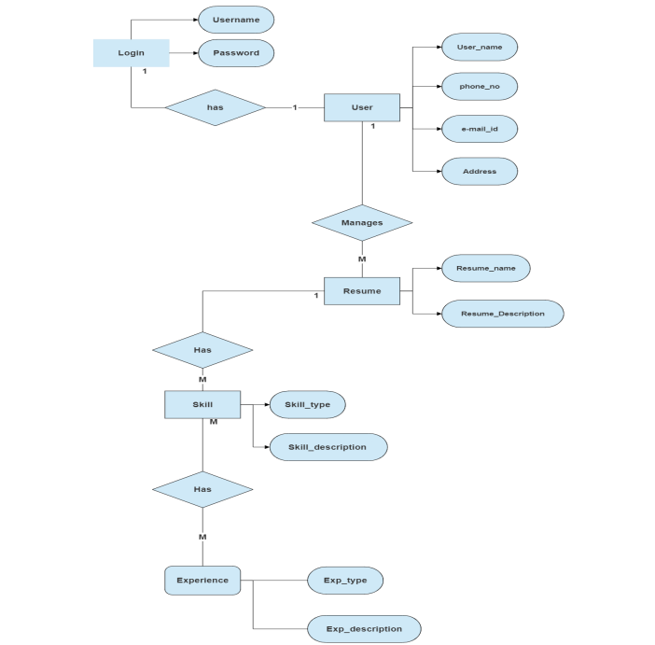
System Design

Slide 13
Preferred Technologies and Methodologies
Natural Language Processing (NLP):
NLP technologies are crucial for understanding and analyzing textual information in resumes and job descriptions.
NLP is a branch of artificial intelligence focused on the interaction between computers and human languages. Techniques such as tokenization, part-of-speech tagging, named entity recognition, and sentiment analysis are commonly used in NLP.
In our solution, we will customize NLP models to accurately parse and understand resume content, extracting key information such as skills, experiences, and achievements. Additionally, we will fine-tune pre-trained language models to better understand domain-specific terminology and job descriptions.

Slide 14
Machine Learning:
ML algorithms play a key role in generating personalized and contextually relevant resume content.
Machine learning algorithms enable computers to learn patterns from data and make predictions or decisions without being explicitly programmed. Supervised learning, unsupervised learning, and reinforcement learning are common approaches in ML.
We will utilize supervised learning techniques to train models on large datasets of resumes and job descriptions. By labeling data with relevant attributes (e.g., skills, experiences), we can train models to generate personalized resume content that aligns with specific job requirements. Additionally, we will explore semi-supervised and active learning techniques to improve model performance with limited labeled data.

Slide 15
Data Analytics:
Data analytics techniques help in understanding user preferences and behavior, enabling continuous improvement of the resume creation process.
Data analytics involves analyzing raw data to uncover insights, trends, and patterns that inform decision-making. Techniques such as descriptive analytics, predictive analytics, and prescriptive analytics are employed to extract actionable insights from data.
We will implement descriptive analytics to understand user behavior and preferences within the resume creation platform. By analyzing usage patterns and feedback, we can identify areas for improvement and prioritize feature development. Additionally, predictive analytics techniques will be used to anticipate user needs and provide proactive recommendations during the resume creation process.

Slide 16
Conclusion
Leveraging advanced technologies: NLP, ML, and Data Analytics.
Customization of NLP models for domain-specific understanding.
Tailoring ML algorithms for personalized resume generation.
Implementation of data analytics for user behavior insights.
Fine-tuning of models to enhance efficiency and accuracy.
Continuous improvement through iterative refinement.
Aim to empower job seekers and enhance career opportunities.

Slide 17
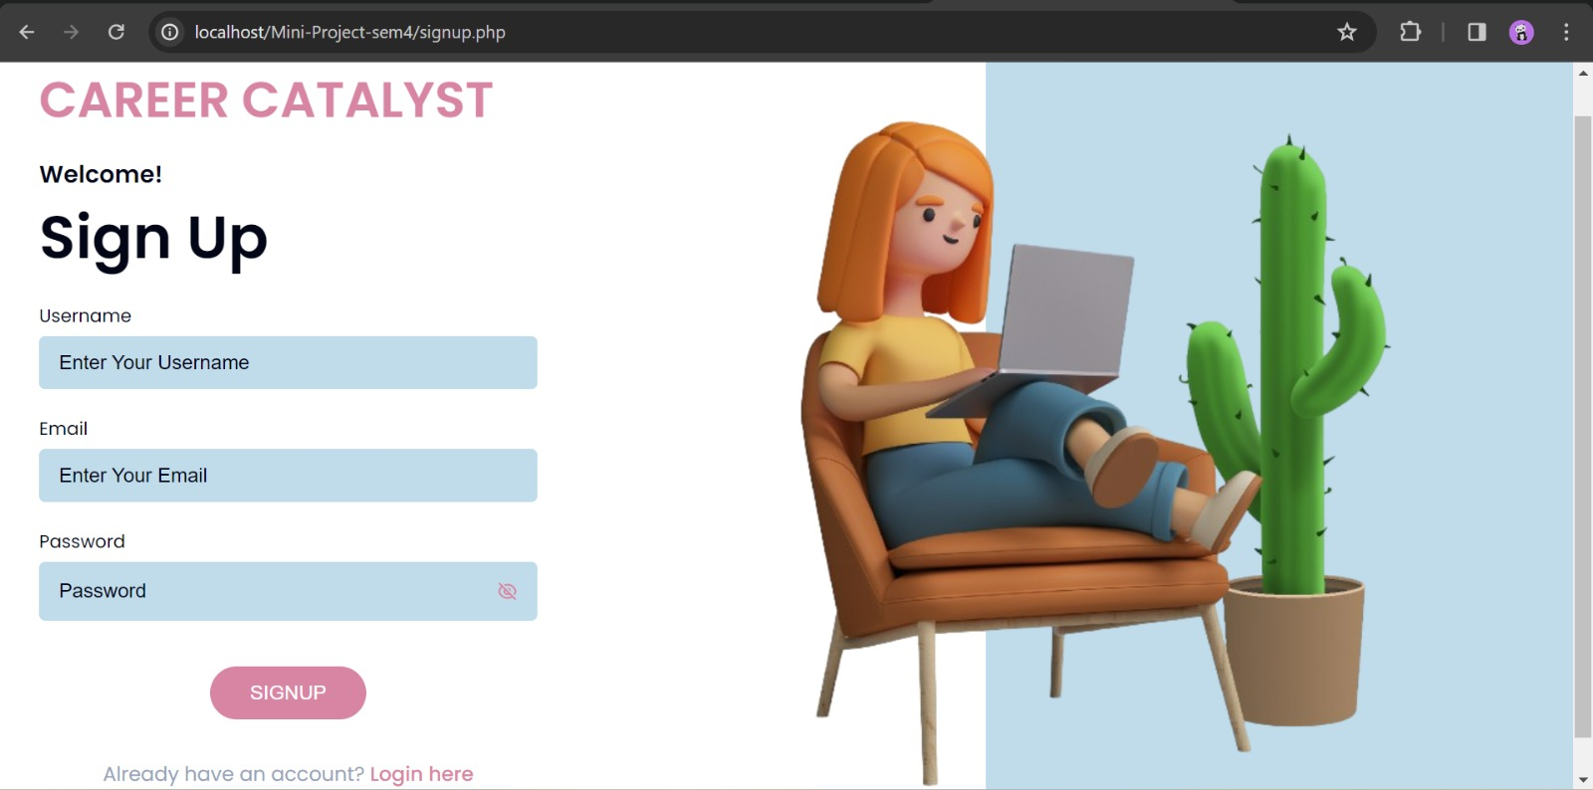
Implementation

Slide 18


Slide 19
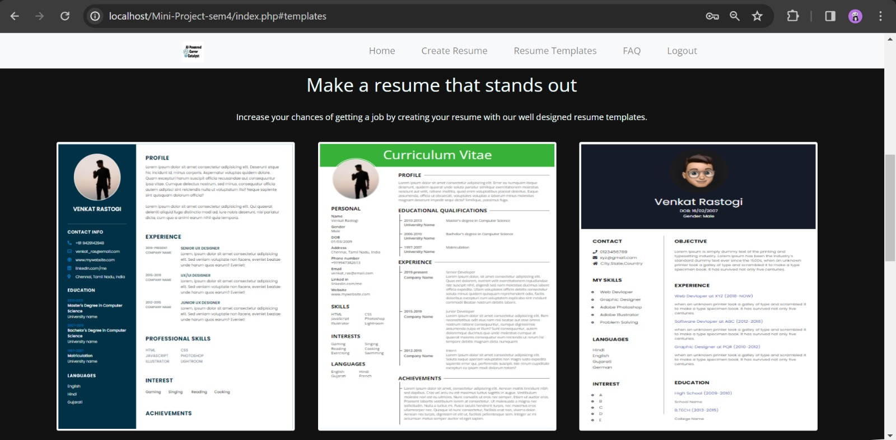

Slide 20
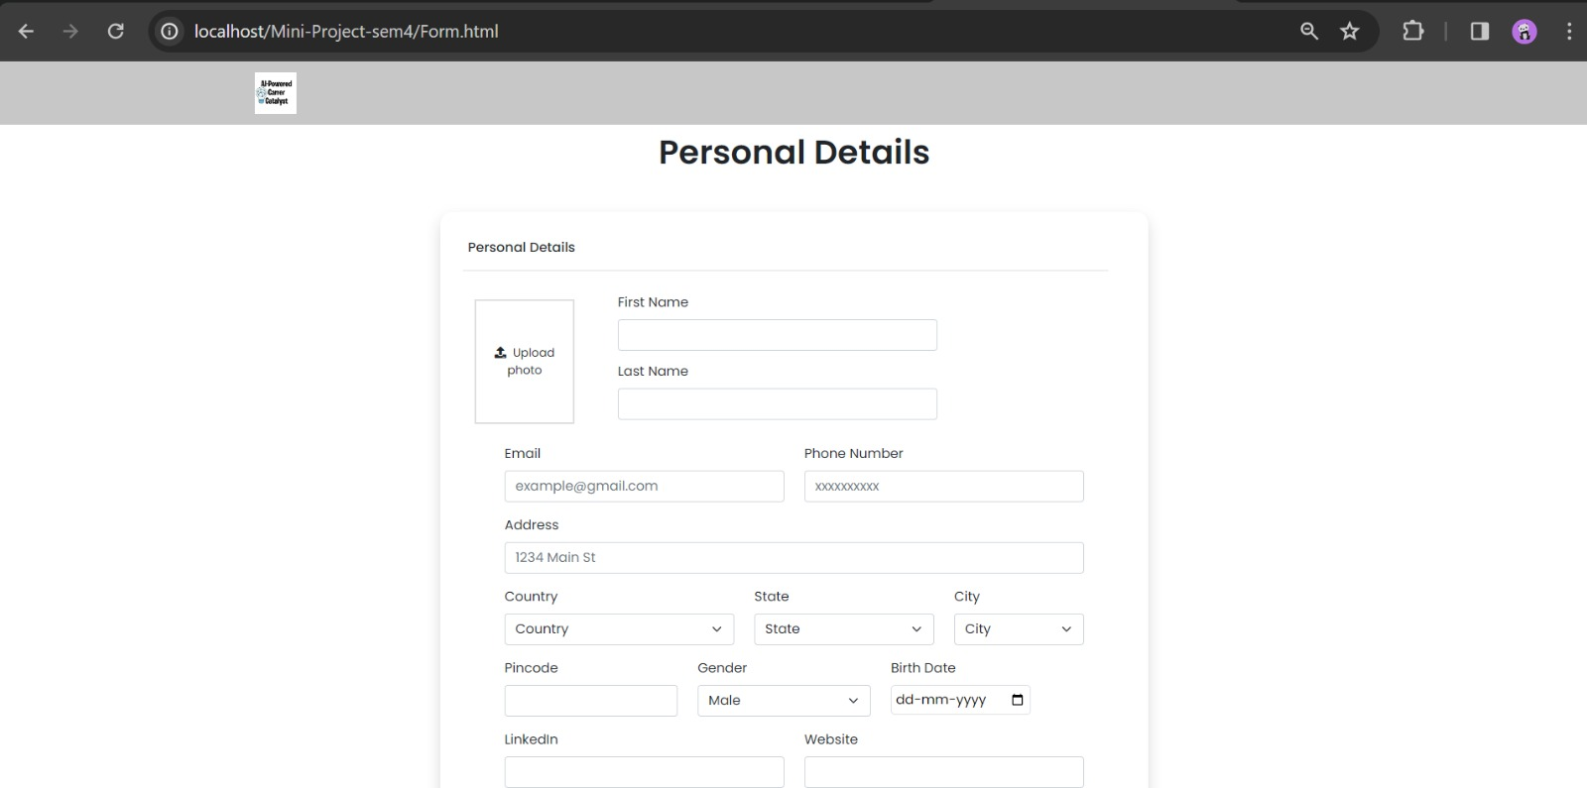

Slide 21
References
E. Forsberg, “Curriculum Vitae – The Course of Life,” Nordic Journal of Studies in Educational Policy, 2016(2-3), 33742, 2016, doi:10.3402/nstep.v2.33742.
D. R. Dickson, K. Nusair, “An HR perspective: the global hunt for talent in the digital age,” Worldwide Hospitality and Tourism Themes, 2(1), 86–93, 2010, doi:10.1108/17554211011012612.
C. Canibano, B. Bozeman, “Curriculum vitae method in science policy and ˜ research evaluation: the state-of-the-art,” Research Evaluation, 18(2), 86–94, 2009, doi:10.3152/095820209X441754.
R. Woolley, T. Turpin, “CV analysis as a complementary methodological approach: investigating the mobility of Australian scientists,” Research Evaluation, 18(2), 143–151, 2009, doi:10.3152/095820209X441808.

Slide 22
THANK YOU!

